Slide 1




Customer Shopping Behavior Analysis
Uncovering Insights for Enhanced Sales, Satisfaction, and Loyalty
Name: Krishna Baish
Role: Associate Data Analyst / Business Intelligence Developer
Degree: BCA (Bachelor of Computer Application)
Final year BCA Student

Slide 2











Executive Summary
Analysis of 3,900 customer transactions reveals key insights that can drive business growth:
Revenue Disparity
High-Spending Discount Users
Unsubscribed Repeat Buyers
Male customers generate 2x higher revenue than female customers
839 customers spend above average while using discounts
2,518 repeat buyers remain unsubscribed, offering conversion opportunities
Business Impact
These insights provide opportunities to optimize marketing strategies, improve customer engagement, and increase sales through targeted promotions.
2 / 12

Slide 3



















Business Problem & Objectives
Business Problem
Project Objectives
Retail company seeking to understand changes in customer shopping behavior across:
Identify Key Customer Segments
Discover distinct customer groups to enable targeted marketing
Uncover Purchase Drivers
Demographics
Product Categories
Sales Channels
Determine factors influencing buying decisions and repeat purchases
Age, gender, location
Items, categories, pricing
Online, in-store, mobile
Provide Actionable Recommendations
Deliver insights for sales, customer satisfaction, and loyalty improvement
Key interest: factors driving consumer decisions and repeat purchases (discounts, reviews, seasons, payment preferences)
3 / 12

Slide 4


















Data & Methodology Overview
Dataset
3,900 purchases from a retail company
Customer Demographics
Purchase Details
Shopping Behavior
Python
SQL
Power BI
Data Preparation
Insights Extraction
Visualization
Python
SQL
Power BI
Data Loading & Cleaning
Structured Queries
Interactive Dashboard
Feature Engineering
Aggregations & Groupings
Data Visualization
Missing Data Handling
Table Joins & Relationships
Parameterized Reports
4 / 12

Slide 5
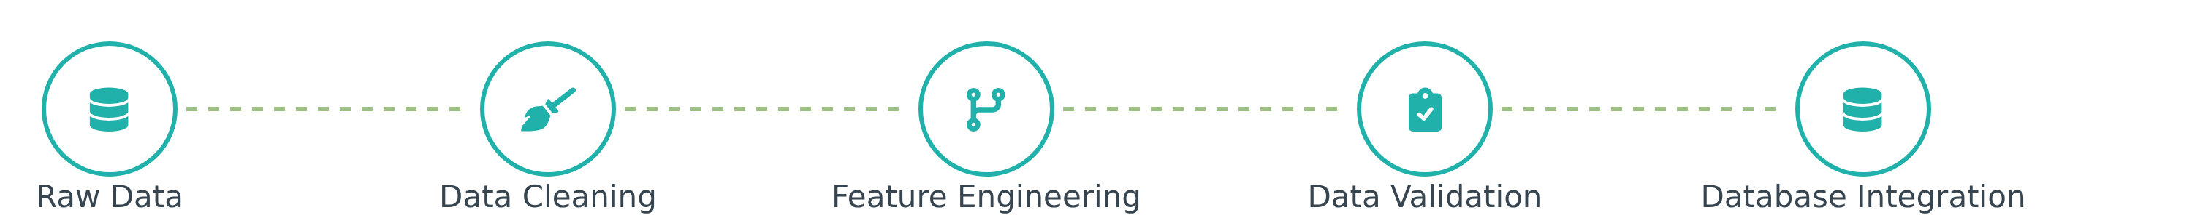






Data Preparation & Feature Engineering
Data Cleaning
Feature Engineering
Database Integration
Python-based data loading with Pandas
Created age_group feature through binning customer ages
Loaded cleaned data into PostgreSQL
Initial exploration with df.info() and .describe()
Created optimized table structures for analysis
Engineered purchase_frequency_days from purchase data
Imputed 37 missing Review Rating values using median per product category
Implemented indexing for query performance
Identified and removed redundant promo_code_used column
Established connection for SQL-based analysis
Column standardization to snake_case
Created additional derived metrics for analysis
Key Outcome: Clean, structured dataset prepared for comprehensive SQL analysis and Power BI visualization.
5 / 12

Slide 6







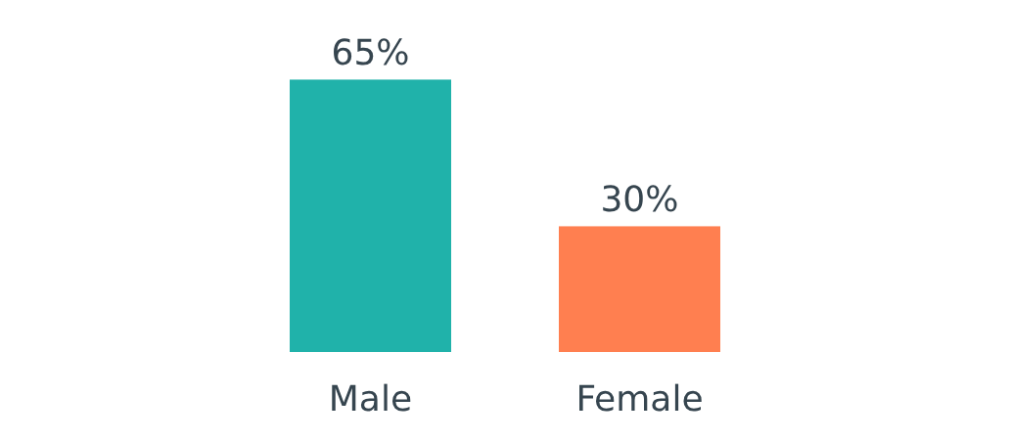
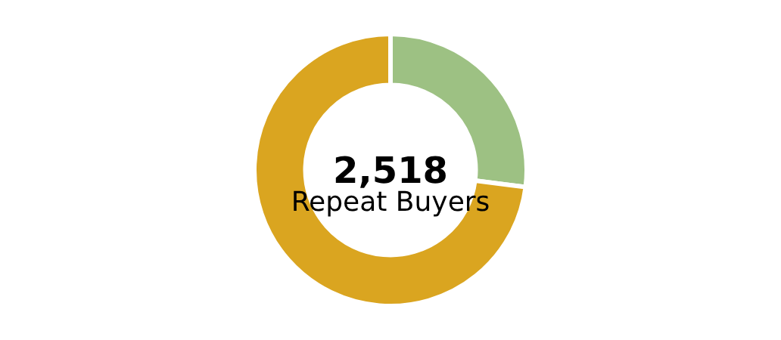




Revenue & Customer Insights
Gender-based Revenue
High-Spending Discount Users
Subscription Conversion
Male customers generated significantly higher revenue than female customers.
Identified 839 customers who utilize discounts while maintaining above-average purchase amounts.
Non-subscribers represent a larger customer base with 2,518 repeat buyers available for conversion.
839
Male customers contributed over double the revenue
High-spending discount users
2,518 unsubscribed repeat buyers represent a significant conversion opportunity
Indicates effective discount targeting
Key Takeaway: Target marketing efforts toward male customers for revenue growth and develop subscription conversion strategies for high-value repeat customers.
6 / 12

Slide 7




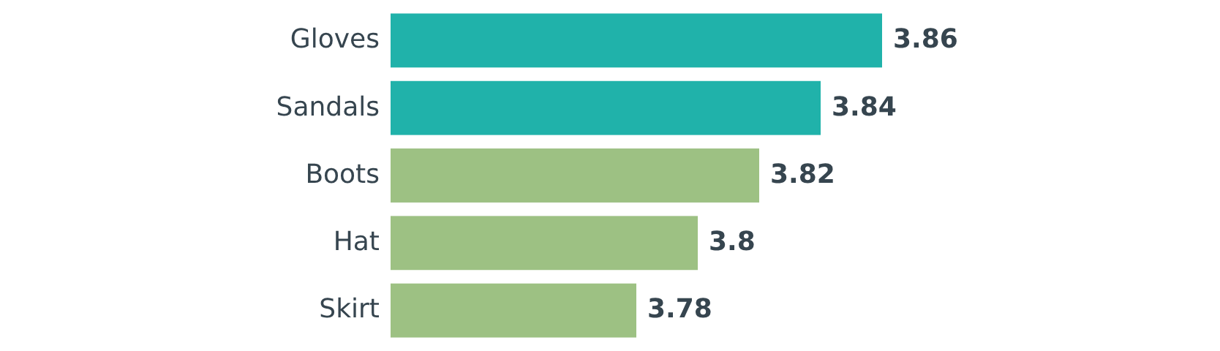





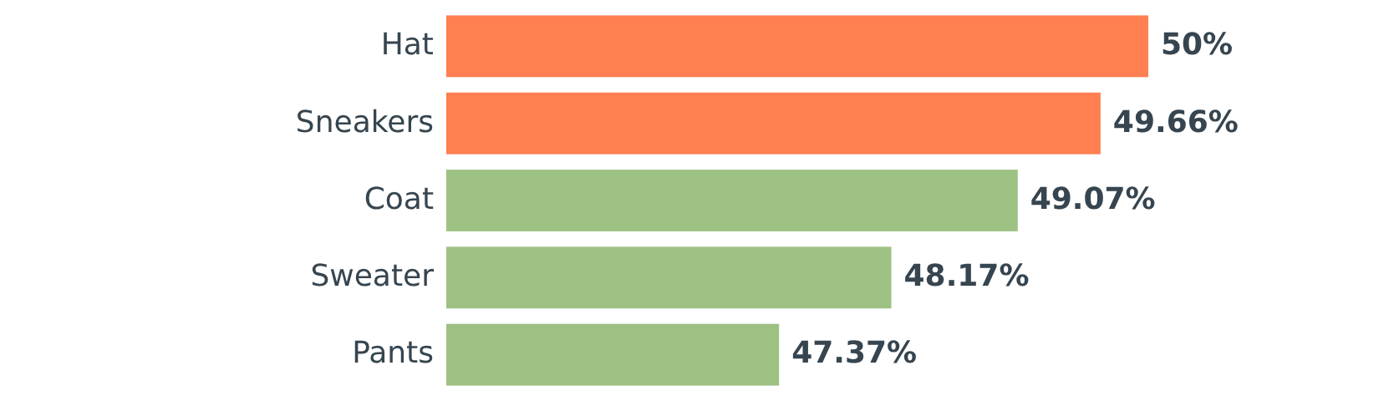
Product Performance Analysis
Top Rated Products
Shipping Type Impact
Standard
VS
Express
$58.46
$60.48
Avg. Purchase
Avg. Purchase
Key Insight: Express shipping users spend $2.02 more on average, suggesting a willingness to pay for speed.
Discount-Dependent Products
7 / 12

Slide 8
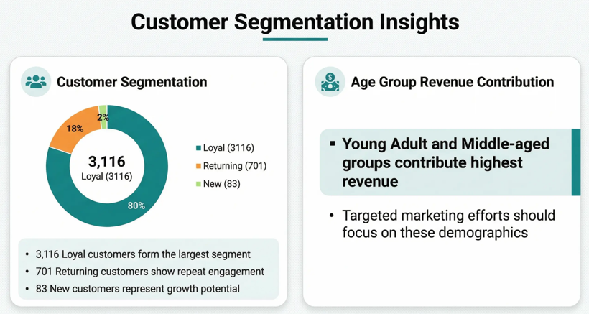

Slide 9

























Power BI Dashboard Overview
Interactive visualization platform for real-time analysis of customer shopping behavior
Total Customers
Avg. Purchase Amount
Avg. Review Rating
3.9K
$59.76
3.75
Last 6 Months
Gender: All
Discount: All
Revenue by Gender
Purchase Frequency Distribution
Male
Female
1 purchase
2 purchases
...
5+ purchases
Interactive filtering & slicers
Drill-down capabilities
Export & share functionality
9 / 12

Slide 10













Strategic Recommendations
Target Unsubscribed Repeat Buyers
Implement Tiered Loyalty Programs
Implement campaigns to convert 2,518 unsubscribed repeat buyers by highlighting exclusive benefits.
Develop a tiered loyalty program to reward frequent purchasers and encourage "Returning" customers to become "Loyal."
Optimize Discount Strategies
Leverage Top-Rated Products
Analyze profitability of discount-dependent products and optimize discount strategies to balance sales boosts with margin control.
Feature highest-rated products in marketing campaigns and website layouts to capitalize on proven customer satisfaction.
Focus on High-Revenue Demographics
Tailor marketing messages to high-revenue age groups and consider premium service offerings for express-shipping users.
Expected Impact
These data-driven strategies can increase subscriber conversion, boost customer retention, optimize marketing spend, and enhance overall revenue.
10 / 12

Slide 11












Technical Skills Demonstrated
Python Data Manipulation
Complex SQL Querying
Power BI Dashboard
Data cleaning and transformation
Structured queries for insights
Interactive visualizations
Feature engineering (age groups, frequency)
Aggregations by customer and product
Calculated metrics and KPIs
Joins across multiple tables
Slicers and filters for interactivity
Missing data handling (median imputation)
Window functions for advanced analysis
Parameterized reports for flexibility
Standardization and consistency checks
Statistical Analysis
Business Recommendation
Descriptive statistics
Data-driven strategy formulation
Hypothesis testing
ROI analysis
Correlation analysis
Stakeholder communication
Confidence intervals
Implementation planning
11 / 12

Slide 12









Next Steps & Future Opportunities
Continued analysis can unlock additional value through advanced techniques:
Predictive Modeling
A/B Testing
Develop models to forecast customer churn and purchase behavior, enabling proactive retention strategies.
Design experiments to evaluate new marketing strategies and optimize discount policies for maximum ROI.
Sentiment Analysis
Personalization
Analyze customer reviews to gain deeper insights into product satisfaction and identify improvement areas.
Develop personalized product recommendations and marketing communications to enhance customer experience.
These initiatives leverage the analyzed data to drive continuous improvement in customer engagement and business performance.
12 / 12

